Slide 2
Microsoft PowerPoint 2016
Certification Guide – Lesson 8: Sharing Presentations

Slide 3
Lesson Objectives
reduce the size of a presentation file
compress and optimize media and pictures
protect and inspect a presentation
use the document inspector
add a digital signature
mark a presentation as final
export presentations to other formats
create a PowerPoint show
package a presentation for CD
print a presentation
share a presentation
publish slides

Slide 4
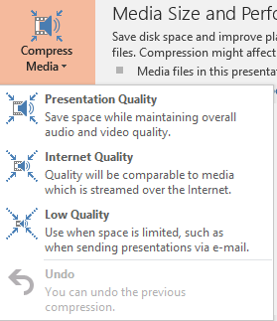
Compressing and Optimizing Media
To compress the presentation file size, click File, in the Info tab, click Compress Media to select compression size
To change the default resolution, click File, click Options, click the Advanced category, in the Image Size and Quality area, select Default resolution size
To delete cropped areas, under Picture Tools, on the Format tab, in the Adjust group, click Compress Pictures
Notes:
221-223
5.2.4

Slide 5
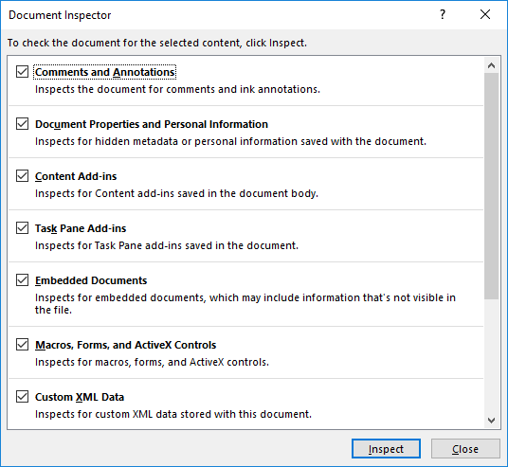
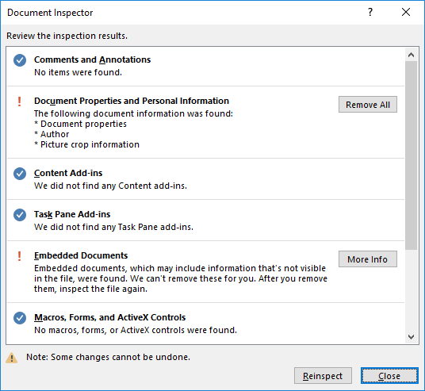
Using the Document Inspector
Click File, in the Info tab, click Check for Issues, click Inspect Document
You are prompted to save before running the inspector
Click Inspect, and then select what information you want to remove or explore
Notes:
224-226
5.2.2

Slide 6
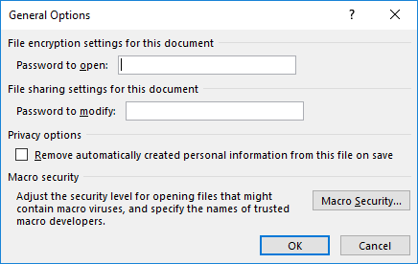
Protecting & Encrypting a Presentation
To protect or encrypt a presentation:
click File, in the Info tab, click Protect Presentation, Encrypt with Password; or
click File, click Save As, click Browse, click Tools, and click General Options
Enter a secure password to prevent others from changing the file
Set for read only
Require password to open and/or to modify
Notes:
226-228
5.2.1

Slide 7
Marking a Presentation as Final
Click File, in the Info area, click Protect Presentation, click Mark as Final
Prompted about using the feature
Backstage shows the file is protected
Edit view shows Edit Anyway in an information bar
Notes:
229-230
5.2.1

Slide 8
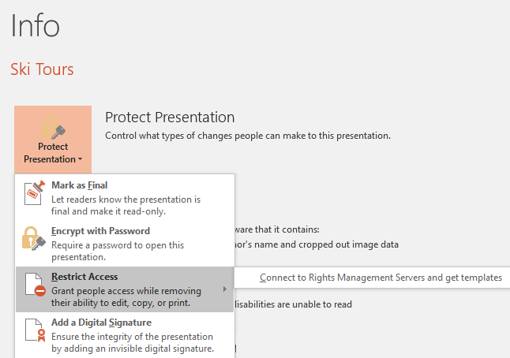
Restricting Access
Click File, in the Info tab, click Protect Presentation, and click Restrict Access
Notes:
230
5.2.1

Slide 9
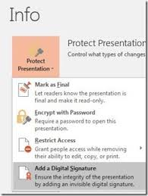
Adding a Digital Signature
Click File, in the Info tab, click Protect Presentation, click Add a Digital Signature
Create a new digital signature or add an existing one
Notes:
231
5.2.1

Slide 10
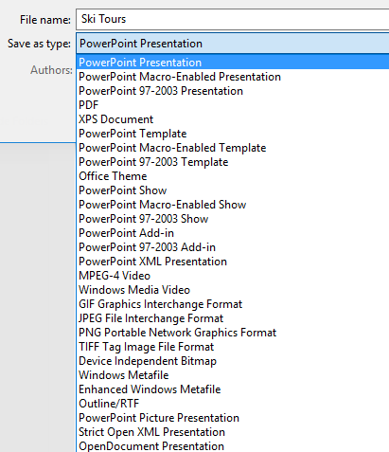
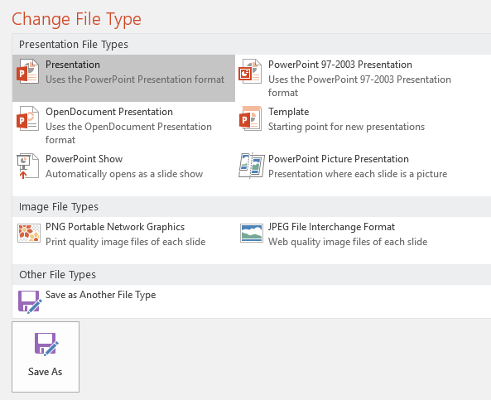
Exporting Presentations in Other Formats
Can save a PowerPoint file in over 25 different file formats
Click File, click Save As, click arrow for Save as type:; or
Click File, click Export, click Change File Type
Notes:
231-232
5.2.2

Slide 11
Creating PowerPoint Shows
A PowerPoint Show does not require the user to have PowerPoint installed to watch the show
To create a PowerPoint show:
click File, click Export, click Change File Type, click PowerPoint Show; or
click File, click Save As, click the arrow for Save as type and click PowerPoint Show (*.ppsx); or
press F12, click the arrow for Save as type and click PowerPoint Show
To open a show for editing, simply open the PowerPoint Show file
Notes:
233-234

Slide 12
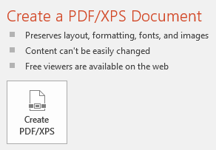
Saving a Presentation as PDF or XPS File
To save a presentation as PDF or XPS format:
click File, click Export, click Create PDF/XS; or
click File, click Save As, click the arrow for Save as type and click PDF or XPS Document; or
press F12, click the arrow for Save as type and click PDF or XPS Document
Once you have converted a presentation to a PDF or XPS file, you cannot converti it back to a PowerPoint presentation.
Notes:
234-235
5.2.5

Slide 13
Saving a Presentation as Images
To save slides as images:
click File, click Export, click Change File Type, click PNG Portable Network Graphics or JPEG File Interchange Format; or
click File, click Save As, click the arrow for Save as type and click PNG Portable Network Graphics Format (*.png) or JPEG File Interchagne Format (*.jpg); or
press F12, click the arrow for Save as type and click PNG Portable Network Graphics Format (*.png) or JPEG File Interchagne Format (*.jpg)
You can also choose other picture formats from the drop-down menu
Notes:
235-236

Slide 14
Saving as a PowerPoint Picture Presentation
To save slides as PowerPoint Picture Presentation (preserves animation and transitions:
click File, click Export, click Change File Type, click PowerPoint Picture Presentation; or
click File, click Save As, click the arrow for Save as type, click PowerPoint Picture Presentation (*.pptx); or
press F12, click the arrow for Save as type, click PowerPoint Picture Presentation.
Notes:
235-236

Slide 15
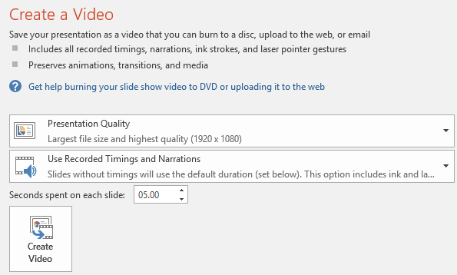
Saving a Presentation as a Video
To save a presentation as a video:
click File, click Export, click Create a Video; or
Click File, click Save As, click the arrow for Save as type, and then select MPEG-4 Video (*.mp4) or Windows Media Video (*.wmv); or
press F12, click the arrow for Save as type, and click MPEG-4 Video or Windows Media Video
Notes:
237
5.2.5

Slide 16
Saving a Presentation as an Outline
To save a presentation as an outline:
click File, click Save As, click the arrow for Save as type, and then select Outline/RTF (*.rtf); or
press F12, click the arrow for Save as type, and then click Outline/RTF
Notes:
238

Slide 17
Saving a Presentation as an OpenDocument
To save a presentation in OpenDocument format:
click File tab, click Export, click Change File Type, click OpenDocument Presentation, and then click Save As; or
click File tab, click Save As, click the arrow for Save as type, and then click OpenDocument Presentation (*.odp); or
press F12, click the arrow for Save as type, and then click OpenDocument Presentation
Notes:
239

Slide 18
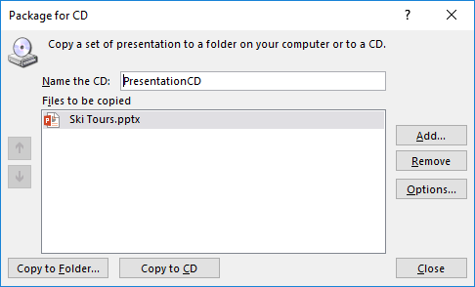
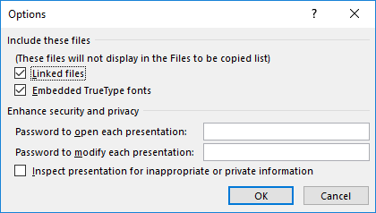
Packaging Presentations for CD
To package a presentation for a CD, click File, click Export, click Package Presentation for CD and click Package for CD
Type a name in Name the CD field, click Add for more files
Choose whether to copy to a folder or a CD
Click Options to determine where you want the packaged files to be copied to
Notes:
239-240
5.2.5

Slide 19
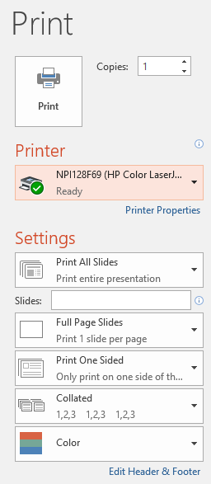
Printing a Presentation
To print a presentation:
click File, click Print; or
press CTRL+P
To select what to print, click Print All Slides and choose from drop-down menu:
Indicate page # to print
What type of pages
What sides
Collated/Uncollated
Color
Notes:
241-242
1.6.1, 1.6.4

Slide 20
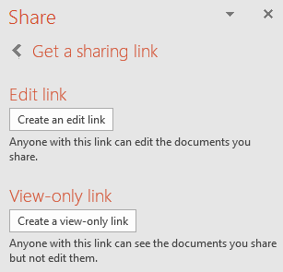
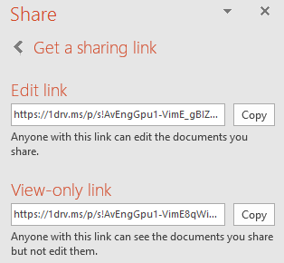
Sharing a Presentation
You need to have a Microsoft account to share files on OneDrive, Sharepoint or Skype
click File, click Share; or
click the Share tab in the upper right corner of the PowerPoint window
To share a file using a link, click Get a sharing link
Notes:
244-245

Slide 21
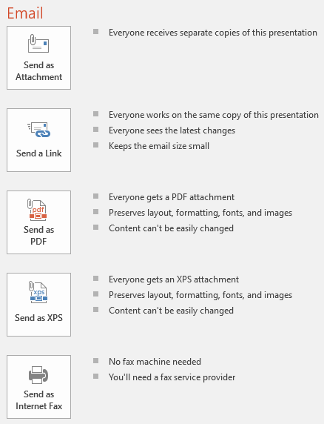
Emailing a Presentation
To share a file using email, click File, click Share, click Email, and select an option
Notes:
246-247

Slide 22
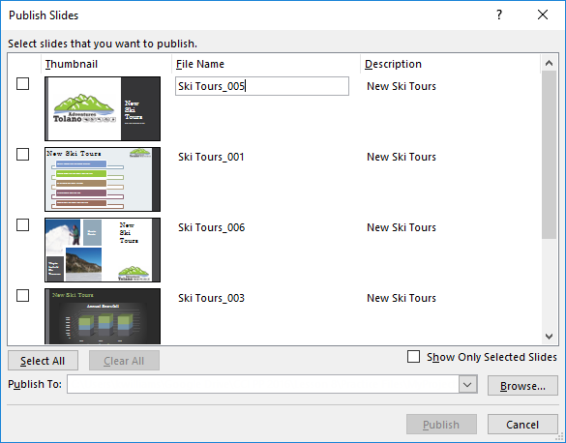
Publishing Slides
To publish slides, you require SharePoint or another organizational structure library
click File, click Share, click Publish Slides, click Publish Slides; or
right-click and click Publish Slides
Notes:
248

Slide 23
Lesson Summary
reduce the size of a presentation file
compress and optimize media and pictures
protect and inspect a presentation
use the document inspector
add a digital signature
mark a presentation as final
export presentations to other formats
create a PowerPoint show
package a presentation for CD
print a presentation
share a presentation
publish slides

